Slide 1
Electronic Communication Aids
BY,
G SUDHANTHIRA M.E.,
A/P BME

Slide 2
Electronic Communication Aids
Electronic communication aids fall under the broader category of Augmentative and Alternative Communication (AAC) devices. These tools assist individuals who have difficulty using natural speech due to conditions such as:
• Autism Spectrum Disorder (ASD)
• Cerebral Palsy (CP)
• Amyotrophic Lateral Sclerosis (ALS) / Motor Neuron Disease (MND)
• Stroke (Aphasia and Dysarthria)
• Traumatic Brain Injury (TBI)
• Parkinson’s Disease
• Down Syndrome
• Other speech and language impairments

Slide 3
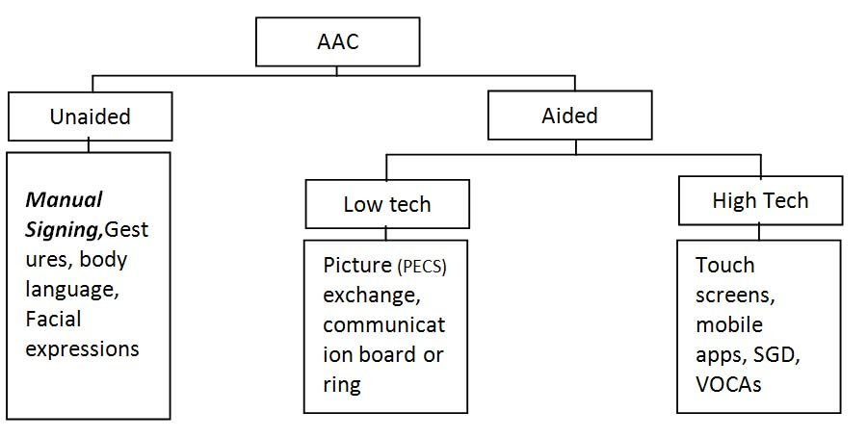
Classification:
Augmentative and Alternative Communication (AAC) devices can be classified as:
  Unaided communicationGestures
      Body language
      Facial expressions
      Signing
  Aided communication
      Pictures
      Symbols
      Communication boards
      Communication books
      AAC devices

Slide 4
What is an AAC device?
An AAC device is a device that has been designed to help a person to communicate.
It might be a non-electronic item like a book or picture cards.
It might be an electronic device that helps a person to express themselves using voice output.
Or it could be an app or a piece of software installed on a mobile phone, computer or tablet.
Types of communication aids:
  Electronic AAC devices
  Paper-based AAC devices

Slide 5
Types of Electronic Communication Aids
Electronic communication aids range from basic text-to-speech tools to sophisticated AI-driven speech-generating devices. The main types include:
  Speech-Generating Devices (SGDs)
  AAC Mobile Applications
  Eye-Tracking and Brain-Computer Interface (BCI) Devices
  Text-to-Speech (TTS) and Speech Recognition Software
  Wearable and Portable AAC Devices

Slide 6
Speech-Generating Devices (SGDs)
Speech-Generating Devices (SGDs) convert text or symbols into speech output. They are used by individuals who have difficulty speaking but can select words, letters, or images to communicate. SGDs can be:
• Text-based SGDs: Users type out messages that the device converts into speech.
• Symbol-based SGDs: Users select pictograms or symbols that generate speech when chosen.

Slide 7
AAC Mobile Applications:
Smartphones and tablets have made AAC more accessible through mobile applications. These apps transform mobile devices into communication tools, offering text-to-speech conversion, symbol-based communication, and predictive text.
• Proloquo2Go (iOS-based communication app with symbol-based interface)
• TouchChat HD (customizable AAC app)
• Avaz AAC (designed for non-verbal individuals)

Slide 8
Eye-Tracking and Brain-Computer Interface (BCI) Devices
For individuals with severe mobility impairments (e.g., locked-in syndrome), eye-tracking and BCI technology offer hands-free communication:
• Eye-Tracking Devices: Users control communication software using their eye movements. Examples include Tobii Eye Tracker and Eyegaze Edge.
• Brain-Computer Interface (BCI): These systems detect brain activity and convert it into commands for communication software. NeuroNode and BrainControl AAC are emerging BCI-based communication aids.

Slide 9
Text-to-Speech (TTS) and Speech Recognition Software
• Text-to-Speech (TTS): Converts written text into spoken language, helping individuals who can type but have difficulty speaking. Examples include Google Text-to-Speech and NaturalReader.
• Speech Recognition Software: Assists those with partial speech impairments by converting spoken language into text. Notable examples include Dragon NaturallySpeaking and Google Voice Typing.

Slide 10
Wearable and Portable AAC Devices
Wearable AAC devices integrate communication technology into small, portable gadgets like smartwatches, wristbands, or lightweight communication aids. Some notable advancements include:
• Voice amplifiers (for individuals with weak speech)
• Wearable symbol-based communicators

Slide 11
Features and Functionalities of Electronic Communication Aids
Customization and Personalization
• Users can modify voice, speech rate, and interface layout.
• Some devices allow users to record and store personal voice samples (voice banking).
Predictive Text and AI Integration
• AI-driven prediction suggests words or phrases based on the user’s communication history.
• Machine learning helps improve efficiency and speed in text-based communication.
Multimodal Communication
• Support for text, images, gestures, and speech output enhances communication flexibility.
• Integration with gesture recognition allows users to communicate through predefined movements.
Connectivity and Compatibility
• Many AAC devices now support Wi-Fi and Bluetooth connectivity, allowing integration with smartphones, computers, and smart home systems.
• Some SGDs are compatible with smart assistants like Alexa and Google Assistant.

Slide 12
Benefits of Electronic Communication Aids
The advantages of electronic communication aids extend beyond speech support, offering life-changing improvements in various aspects of daily living:
Enhanced Communication
• Allows individuals to express their thoughts, needs, and emotions clearly.
• Facilitates interactions with family, friends, and caregivers.
Greater Independence
• Reduces dependence on caregivers for basic communication needs.
• Enables users to engage in social, academic, and professional activities.
Improved Social Inclusion and Mental Well-Being
• Helps users build relationships and participate in community activities.
• Reduces frustration and isolation associated with communication difficulties.
Support for Education and Employment
• AAC devices assist students with disabilities in learning environments.
• Many professionals use SGDs to continue working despite speech impairments.

Slide 13
Challenges and Limitations
High Cost and Accessibility Issues
• Advanced SGDs and eye-tracking devices can be expensive.
• Funding and insurance coverage vary across different regions.
Learning Curve and User Training
• Some users require extensive training to operate complex AAC devices.
• Caregivers and educators may need special training to assist users.
Dependence on Technology and Power Sources
• Battery-operated devices require regular charging, which may limit usage in certain situations.
• Device malfunctions or software errors can disrupt communication.
Limited Language and Cultural Adaptation
• Many AAC solutions lack support for non-English languages or regional dialects.
• Customization for different linguistic and cultural needs is still evolving.

Slide 14
Future Trends
AI-Powered Speech Synthesis and Personalization
• Deep learning models are improving natural-sounding synthetic voices.
• AI-driven systems can adapt to users’ unique communication patterns.
Augmented Reality (AR) and Virtual Reality (VR) Integration
• AR-based AAC tools may enhance communication by providing visual prompts.
• VR applications can assist in speech therapy and communication training.
More Affordable and Portable Devices
• Research is focusing on making AAC devices more affordable for wider accessibility.
• Miniaturized wearables and voice-enabled smart devices are becoming more common.
Brain-Computer Interface (BCI) Developments
• Improved BCI technology may allow seamless, thought-driven communication.
• Non-invasive BCI solutions are being developed for mainstream use.

